Slide 1
MQ Objects
Queue Manager
Types of Queues
Channels
Process
Listeners

Slide 2
About the Queue Manager
  Queue Manager manages MQ objects for application.
  It provides MQI interface to application to work with MQ.
  Queue manager name should be unique in network to which it is connected.
  It makes use of existing networking facilities for transferring the messages from one QMGR to another.

Slide 3
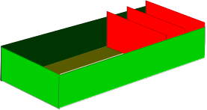
Queues
QM1
Windows XP
Container for messages
Managed by the Queue Manager
Opened by a program for input, output & inquire.
Arrival of message can trigger job or program

Slide 4
Queue Types
  Predefined
  Dynamic Queues
Predefined types:
  Local
  Remote
  Transmission
  Alias
  Dynamic
  Model
  Dead Letter
  System

Slide 5
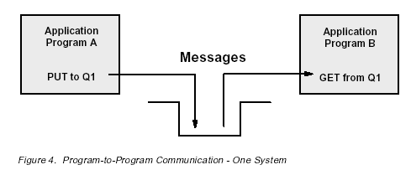
Local Queues
  Classified as local if owned by the queue manager to which the program is connected
  The local queue holds the physical message put on the queue
  Commad: Define Qlocal(my_Localq)

Slide 6
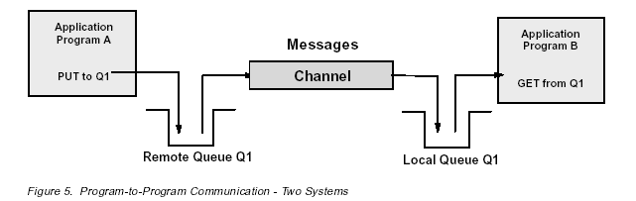
Remote Queue: It is used to transmit messages from one queue manager to another queue manager.
      Define Qremote(my.remoteq) RNAME(my_localq) RQMNAME(QM2) Xmitq(QM2.Xmitq)

Slide 7
Alias Queues
  Pointer to another queue.
  Enables programs to access a queue using different names
  Command: Define QAlias(my.Aliasq) targq(my_localq)
  Scenarios:
  1. For satisfying different Naming conventions
  2. Different level of access
  3. For hiding the actual queue information

Slide 8
Transmission Queue
  Used to store message destined for another queue manager
  Included in the channel definition
  IT can be used for channel triggering.
  Define qlocal(my.xmitq) usage(xmitq)
Model Queues
  IT defines set of queue attributes that are used as template for creating Dynamic Qs.
  It doesn’t store any messages.
  Application issues MQOPEN call on model queue to create a dynamic queue.
  Define qmodel(my.modelq) deftype(permdyn)
Cluster Queues
  A queue hosted by a cluster queue manager and made available to the other queue managers in the cluster.

Slide 9
Queues: Special types of Local Queue
Initiation Queue
  Used by the Queue Manager to put a trigger message when a trigger event occurs on an application queue
  Used in triggering
  It holds the trigger messages.
Dead-Letter Queue (DLQ)
  Used by the Queue Manager to store messages that cannot be delivered
  Needs to be defined on the Queue Manager
  Best Practise to have a DLQ on every queue manager
System Default Queues
  Created when you create the Queue Manager
  Used as a template for all user defined queues

Slide 10
Process: It defines an application that starts in response to a trigger event generated in QMGR
  APPLTYPE
  APPLICID
  ENVRDATA
  USERDATA
Namelist: It contain list of other MQ objects.

Slide 11
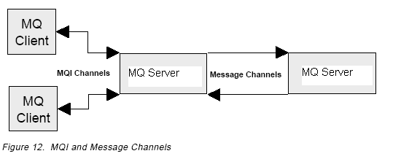
Channel
A channel is a logical communication link. In MQ Series, there are two different kinds of channels
1. Message channels
A message channel connects two queue managers via message channel agents (MCA s).
2. MQI channels
A Message Queue Interface (MQI) channel connects an MQ Series client and MQ Series server.

Slide 12
MQSeries Objects: Message Channels
provide a communication path between two queue managers on the same, or different, platforms.
A message channel can transmit messages in one direction only. If two-way communication is required between two queue managers, two message channels are required.
Messages on channel are placed by MCA, which is program controlled by QMGR

Slide 13
MQSeries Objects: Message Channels(2)
Types of message channels:
  Sender - initiates connection to Receiver
  Server - Accepts request to start from requester, then becomes Sender
  Receiver - Passive; waits for initiation sequence form Sender
  Requester - Active at start, then becomes Receiver
  Cluster-sender (used amongst Cluster Queue Managers)
  Cluster-receiver (ditto)

Slide 14
MQSeries: Assured Delivery
Sender (sdr)-receiver (rcvr)
Server (svr)-requester (rqstr)
Sender (sdr)-requester (RQSTR)
Clustersender (CLUSSDR)-cluster receiver (CLUSRCVR)
MQI Channels
  Client connection channel (clntconn)
  Server connection channel (svrconn)

Slide 15
Listener
  It’s a process which listens continuously on to a queue manager port.
  Default port 1414
  Define listener(my.listener.12345) trptype(tcp) port(12345)

Slide 16
